Slide 2
Objectives
Understand how flowcharts are used to solve problems
Understand flowchart symbols including:
Processes, subroutines, input/output, decisions, terminators
Create, interpret, correct, complete and amend algorithms using flowcharts

Slide 3


Starter
What is an algorithm?

Slide 4
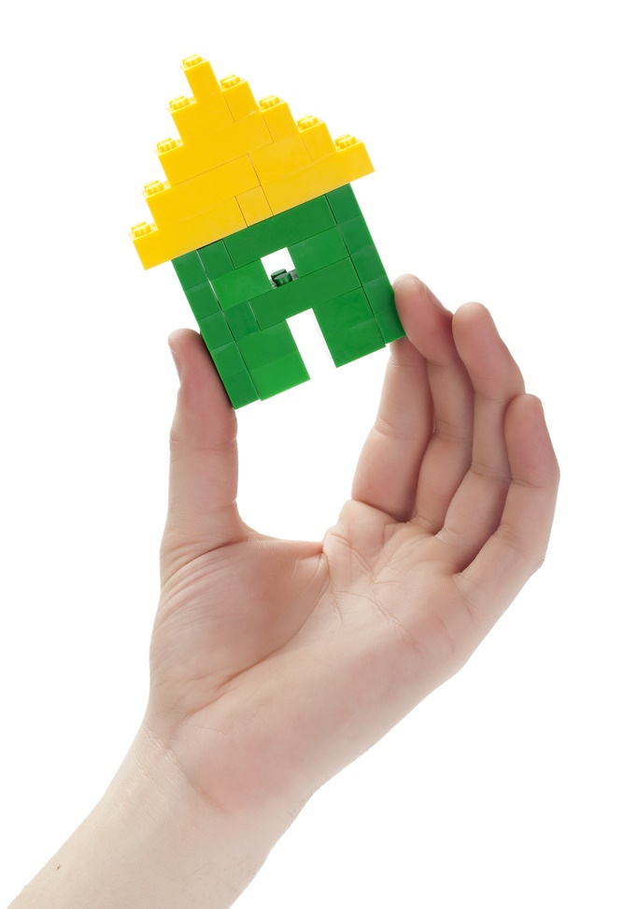

Algorithms
An algorithm is a set of instructions for solving a problem or completing a task
The task could be:
Making a chocolate cake
Summing the numbers 1 to 1000
Building a Lego model
One way of showing how an algorithm works is to use a flow chart

Slide 5
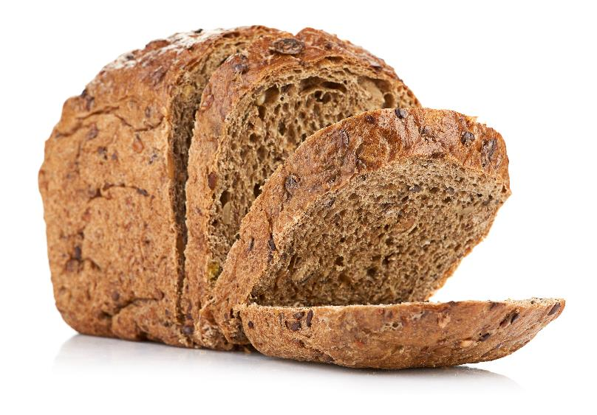
Purpose
Start
Add flour to bowl
Look at the flowchart
What is it a flowchart for?
Describe the processes involved in the algorithm
Add water
Mix
Too much flour?
Yes
Add water
No
Too much water?
Yes
Add flour
No
Knead dough
Put in oven
Stop

Slide 6
Purpose
Start
Add flour to bowl
It is a flowchart for making bread
The flour and water are mixed together
If there is too much flour, more water is added
If there is too much water, more flour is added
Once correct, the dough is kneaded
The dough is put in the oven
Add water
Mix
Too much flour?
Yes
Add water
No
Too much water?
Yes
Add flour
No
Knead dough
Put in oven
Too much flour?
Stop

Slide 7
Writing algorithms
Flow charts are one way that shows how a problem may be solved
How many different flowchart symbols do you know?
What do each of the symbols you know mean?
Start

Slide 8
Flowchart symbols
Terminal
No
Input / Output
Decision
Yes
Start
INPUT Grade
No
Is Count = 10?
Stop
OUTPUT Total
Yes

Slide 9
Flowchart symbols
Process
Sub program
Line Shows direction of flow
count ← count + 1
showMenu()
total ← total + mark
search("Jack")

Slide 10
Drawing a flowchart
An algorithm is a series of steps to solve a problem or carry out a task
What algorithm does this flowchart represent?
Start
OUTPUT "Choose an ID"
INPUT ID
Yes
Is this ID already in use?
OUTPUT "Choose another ID"
No
Save(ID)
Stop

Slide 11
Counting
Start
The algorithm shows how it is possible to count using a flowchart
The statement count ← count + 1 means “Add 1 to the variable called count”
Explain exactly what the program will do?
count ← 0
count ← count + 1
OUTPUT count
Is count < 1000?
Yes
Is count < 1000?
No
Stop

Slide 12
Counting
Start
The program outputs:
1
2
…
999
Note that the program won’t output 0 or 1000
count ← 0
count ← count + 1
OUTPUT count
Is count < 1000?
Yes
No
Stop

Slide 13
Worksheet 2
Complete Task 1 and Task 2 on Worksheet 2

Slide 14
Finding the maximum
The flowchart shows the algorithm that will find the maximum of two numbers
Remember when using a decision symbol that you must label the different branches that come out of it – in this case “Yes” and “No”
Start
INPUT num1
INPUT num2
num1 > num2
Yes
OUTPUT num1
No
OUTPUT num2
Stop

Slide 15
Sub programs
Sub programs are used when you wish to call another procedure or function
They use a box with lines either side
In this example, findVAT is called from the sub program box
The findVAT sub program then runs and returns the answer to where it was called
Start
findVAT(n)
INPUT total
VAT ← n * 0.2
total ← total + findVAT(total)
Return VAT
OUTPUT total
Stop
total = total + count

Slide 16
Worksheet 2
Complete Task 3, Task 4 and Task 5 on Worksheet 2

Slide 17
Plenary
What are each of the following symbols?
Explain to a partner what each one does

Slide 18
Plenary
What are each of the following symbols?
Explain to a partner what each one does
Decision – change flow based on a decision
Input / Output
Process – Maths operations and assignment of variables
Sub program – call a different function or procedure
Line – shows direction of flow
Terminal – for start and stop

